Slide 1

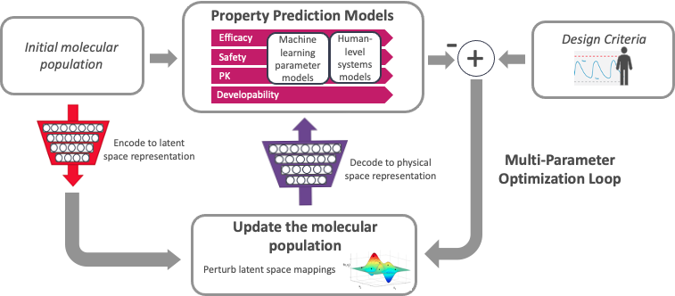
Titli Sarkar
ATOM Team
BIDS SDSI
Accelerating Therapeutics for Opportunities in Medicine (Cancer Research)
ATOM Pipeline
Shared Space
Availability (Github)
Model and Data Clearinghouse (MoDaC)
Molecular data library - Open curated and model-ready database
2. AMPL
AMPL Tutorial
Publicly available curated dataset
AMPL Predictive Models
Distributed collaborative public facing API
Data Management/Transfer
Configurable access levels
Transferability
3. GMD
GMD Pipeline
AI and computing-driven molecular discovery and optimization
AMPL Pipeline
GMD Pilot Project –
Neurocrine H1 Design
Data Ingestion + Curation
Model Training + Tuning
Featurization
Prediction Generation
Visualization + Analysis
3. GMD - A high-performance platform for parallel optimization of efficacy, safety, and pharmacokinetics
Data Lake
Model Zoo
Results DB
Example – GMD Pilot design projects in cancer, infectious disease and other areas;
H1 histamine receptor pKi > 9
M2 muscarinic receptor pKi < 6
2. AMPL (ATOM Modeling PlpeLine) –
Predictive modeling: training, optimization, and property prediction
atomscience.org | @ATOM_consortium | #ATOMscience

Slide 2
ATOM
AMPL, GMD
Shared spaces (modac, git)
Transferability (shared spaces)
Models, tutorials, pipeline
Dataset:https://github.com/ATOMScience-org/AMPL/tree/master/atomsci/ddm/examples/tutorials/datasets
Models link

Slide 3
Timeline
April 27-28, 2022
Registration Deadline: April 6
Prep: (Poster Blitz 3 mins presentation)
Collect information on poster requirements
Collect contents (via teams)
Put them in a template (they provide?) with edits and proper layout
Review:
Submit: Deadline

Slide 4
Topics
1. AMPL overview
2. GMD overview
3. GMD demonstration via Histamine project (https://mailchi.mp/1c4b421255cb/updates-atom-october-2021-newsletter)
Neurocrin article (Kevin)? GMD experiment
MoDaC, git AMPL
AMPL new models, dataset
Livermore software DB ?

Slide 5
AMPL New Models
https://github.com/ATOMScience-org/AMPL/commit/31aa274e2c22c946cbf10ccb0c3b8107936b7cac
Jan 12, 2022 - added max_epochs to model parameters and reduced training length to shorten test time (by stewarthe6)
atomsci/ddm/pipeline/compare_models.py
line 326 - model_info['max_epochs'] = model_metadata['max_epochs’]
atomsci/ddm/pipeline/model_wrapper.py
Line 2698 - nn_metadata['max_epochs'] = self.params.max_epochs
atomsci/ddm/test/integrative/compare_models/jsons/reg_config_H1_fit_AttentiveFPModel.json
early_stopping_patience: 3 (30),
max_epochs: 5 (200),
perf_threshold: -10000000 (0.90)

Slide 6
AMPL New Models
atomsci/ddm/test/integrative/compare_models/jsons/reg_config_H1_fit_GCNModel.json
early_stopping_patience: 4 (10),
max_epochs: 5(50)
perf_threshold: -1000000 (0.40)
atomsci/ddm/test/integrative/compare_models/jsons/reg_config_H1_fit_MPNNModel.json
max_epochs: 5(4)
satomsci/ddm/test/integrative/compare_models/jsons/reg_config_H1_fit_PytorchMPNNModel.json
early_stopping_patience: 3 (30),
max_epochs: 5(100)
perf_threshold: -1000000 (0.30)
atomsci/ddm/test/integrative/compare_models/jsons/reg_config_delaney_fit_NN_graphconv.json
early_stopping_patience: 4 (75),
max_epochs: 5(500)
atomsci/ddm/test/integrative/compare_models/test_filesystem_perf_results.py
max_epochs: 5(500)
atomsci/ddm/test/integrative/dc_models/reg_config_H1_fit_GraphConvModel.json
early_stopping_patience: 20 (30),
max_epochs: 100(200)
perf_threshold: 0.3(0.45)

Slide 7
Questions
Title?
Authors, presenter?
All attendees will be required to register as a participant or spectator to gain access to the event.
Which Organization logos?
Which organization template?
Group name?
Need help on GMD

Slide 8
Content
Experts in fields from machine learning to cancer biology with a goal to accelerate drug discovery (www.atomscience.org)
Founding members + AMPL team + DILI, PK, GMD teams

Slide 9
ATOM Pipeline
AMPL Pipeline
Data Ingestion + Curation
Model Training + Tuning
Featurization
Prediction Generation
Visualization + Analysis
Data Lake
Model Zoo
Results DB
Benefits:
Easy integration of diverse datasets
Enables portability of models and reproducibility of results
Rapid exploration of descriptors and model architectures for each data set
The ATOM molecular design process integrates predictive models, multi-parameter optimization, and active learning

Slide 10





MoDac
Model and Data Clearinghouse (MoDaC) Distributing collaborative models and data to the community
Data Services API Core
Web Application
User Database
Transfer
Endpoints
Public facing web application
Extensible metadata structure
Configurable access levels
Data transfer options - AWS S3, Globus, Local
Data Management options Upload/Download/ Search
Bridge to the broader cancer data ecosystem
Metadata Server
Globus
Data
Metadata Store
Local
Object Repository

Slide 11
Neurocrine H1 Design Pilot Project-1
machine learning models for H1, M2 and hERG binding
single-concentration data provided by Neurocrine for 1,900 compounds
multi-concentration pKi data from ChEMBL and GoStar
unique hybrid model architecture to enable use of noisy single-point data to improve model accuracy in specialized regions of chemical space not covered by existing datasets, without requiring the expense of performing full-curve pKi measurements.
Identified compounds which are potent at lower therapeutically relevant doses, provided the list to Neurocrine for testing at a lower concentration for which those measurements would be most informative
Used them to train models for subsequent GMD runs

Slide 12
Neurocrine H1 Design Pilot Project-2
challenge for the generative design process - Optimizing compounds for predicted H1 selectivity produced chemical structures that were far beyond the applicability domain of the models
adding applicability domain constraints to the GMD optimization criteria, keep the generated compounds within regions of chemical space where the models are reliable
GMD loop was run for 250 generations on an initial 25,000-compound set, producing ~1.75 million compounds over 60 hours of elapsed time. Over 200 compounds met all quality panel design criteria (efficacy, safety, and developability). The GMD loop continued to explore new parts of chemical space even after many generations.

Slide 13
Neurocrine H1 Design Pilot Project-3

Slide 14
Questions ?
Data - ChEMBL + GoStar – where?
K_{i}

